Slide 1

Nanotechnology-
Advancements in Polymer
Nanocomposites
Nancoposites

Slide 2
INDEX
Introduction
Definitions
Implementation
Applications
Conclusions
References

Slide 3
Introduction
The field of nanotechnology is one of the most popular areas
for current research and development in all technical
disciplines.
This obviously includes polymer science and technology which covers a broad range of topics -
Microelectronics or nanoelectronics, polymer-based particles, fuel cell electrode polymer bound catalysts.
Layer-by and layer self-assembled polymer films, electrospun.
Nanofibers, imprint lithography, polymer blends and nanocomposites.

Slide 4
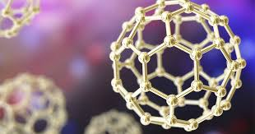
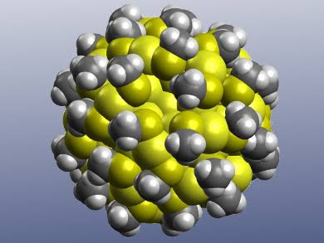
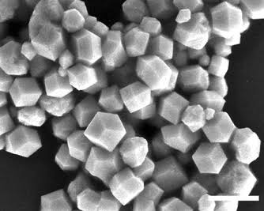
Definitions
Nanoparticles-A solid particle in the range 1-100nm that could be nanocrystallites an aggregate of crystallites or a single crystalline.
Nanoclusters – A collection of units (atoms or reactive molecules) of upto about 50 units.
Nanocrystal – A solid particle that is a single crystal in the nanometer range.

Slide 5
Nanocomposites
Thermal
Analysis
Infrared
Spectroscopy
X-Ray Diffraction
IMPLEMENTATION

Slide 6
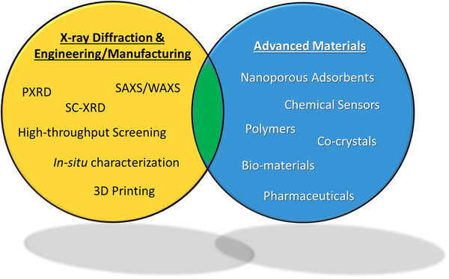
X-RAY DIFFRACTION
X-ray diffraction has played a central role in identifying and characterizing solids since the early part of this century.
X-ray diffraction pattern of amorphous polymer will not show any sharp and highly intense peaks whereas the nanocomposites of amorphous polymer show sharp and highly intense peaks.

Slide 7
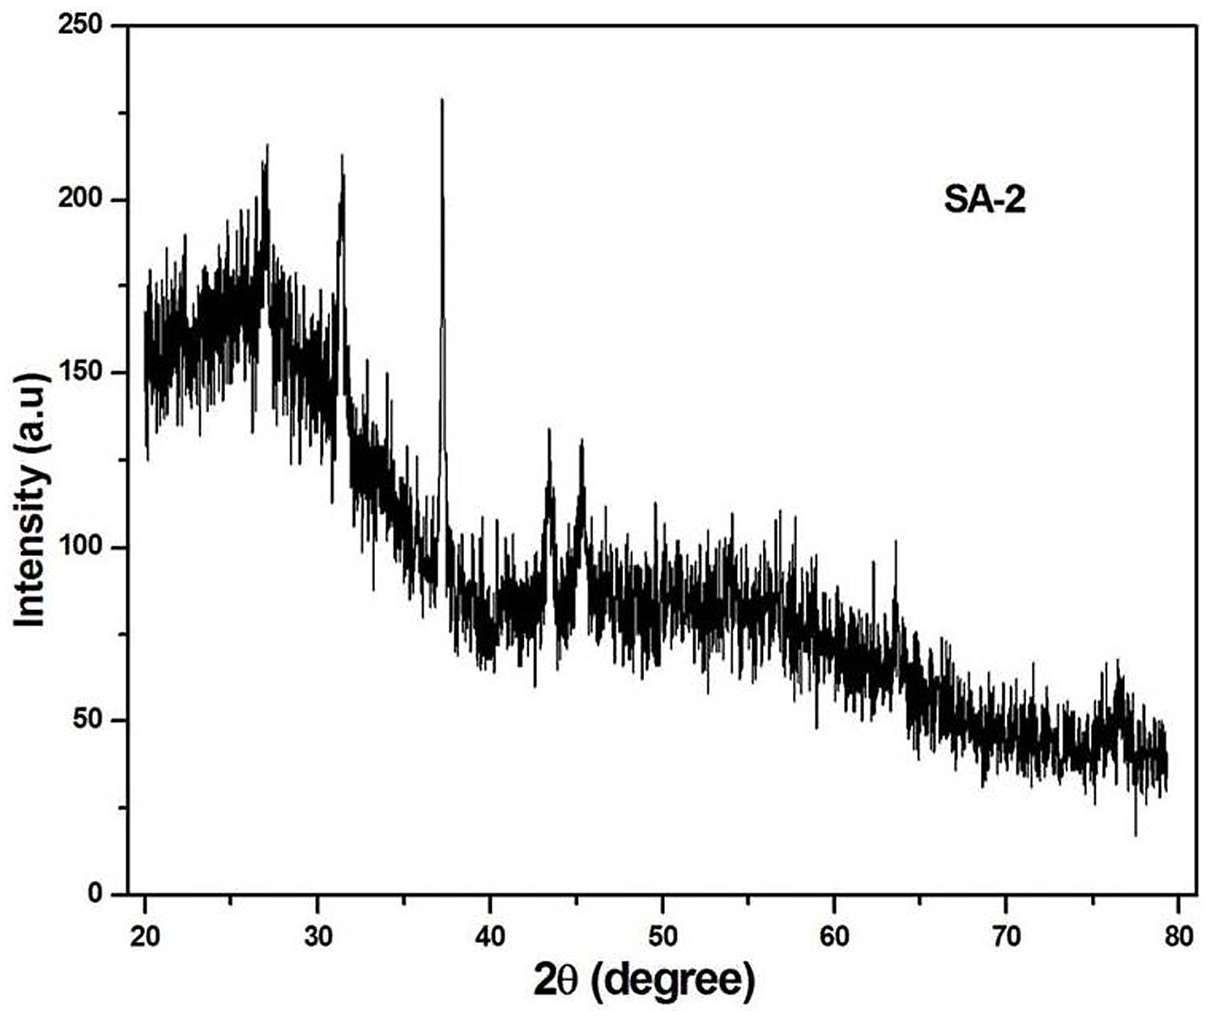
X-RAY DIFFRACTION
This is due to the development if crystallinity in the amorphous polymer.
Highly Intense peaks occur in the pattern due to presence of inserted gamma FeO materials in the rubber matrix.
X Ray diffraction has most commonly been used for routine characterization as well as for detailed structural elucidation.

Slide 8
THERMAL ANALYSIS
Thermal analysis may be defined as the measurement of physical and chemical properties of materials as a function of temperature.
The two main thermal analysis techniques are thermo gravimetric analysis (TGA) which automatically records the change in weight of a sample as a function of either temperature or time.
The differential thermal analysis (DTA), which measures the difference in temperature ΔT, between a sample and an inert reference material as a function of temperature; DTA therefore detects change in heat content.
A technique closely related but modified to DTA is differential scanning calorimetry (DSC).

Slide 9
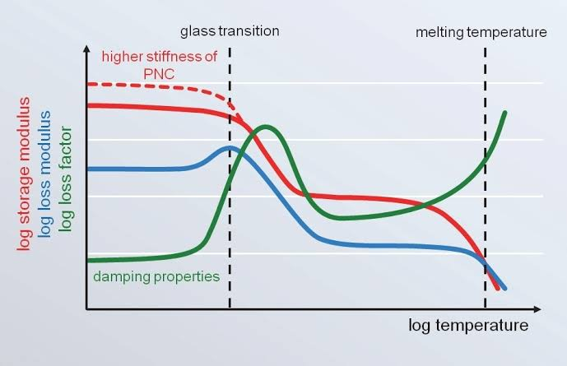
THERMAL ANALYSIS
In DSC, the equipment is designed to allow a quantitative measure of the enthalpy changes, ( ΔH) that occurs in a sample as a function of either temperature or time.
DSC is an analytical tool which helps to understand the thermal behavior of polymer nanocomposites.
It helps in finding glass transition temperature (Tg) of polymer and its polymer composites.
The increase in Tg values shows the presence of inorganic materials in the polymer matrix.

Slide 10
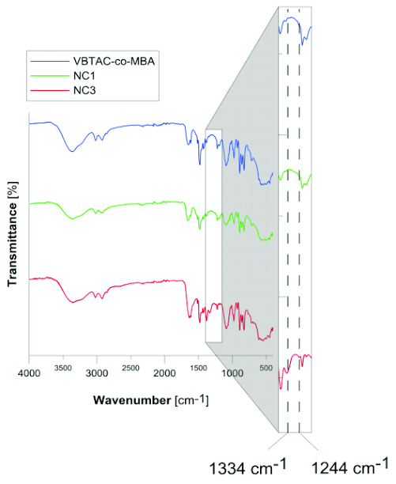
INFRARED SPECTROSCOPY
Infrared spectroscopy is one of the most powerful analytical techniques, which offers the possibility of chemical identification.
This technique when coupled with intensity measurements may be used for quantitative analysis.
One of the important advantages of infrared spectroscopy over' the other usual methods of structural analysis (X-ray diffraction, electron spin resonance, etc.) is that it provides information about the structure of a molecule quickly, without tiresome evaluation methods.
This method can solve many problems in organic chemistry (polymeric materials) and coordination chemistry, and also advantageously complements the results obtained by other methods.

Slide 11
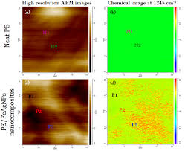
INFRARED SPECTROSCOPY
This technique is based upon the simple fact that a chemical substance shows markedselective absorption in the infrared region giving rise to dose-packed absorption bands called an IR absorption spectrum, over a wide wavelength range.
Various bands will be present in the IR spectrum, which will correspond to the characteristic functional groups and bonds present in chemical substance.
Thus an IR spectrum of a chemical substance is a fingerprint for its identification.
IR spectrum of polymer nanocomposite shows the presence of both nanomaterials and polymers (depending upon the polymer chain) at various frequencies.

Slide 12
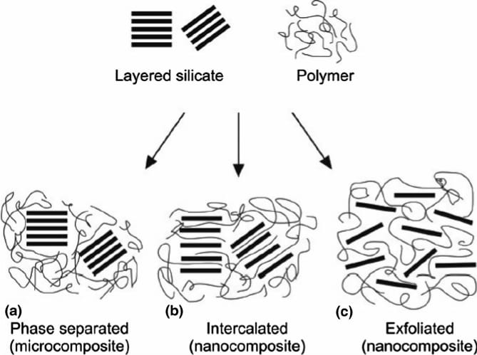
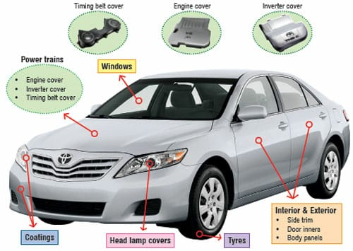
APPLICATIONS

Slide 13
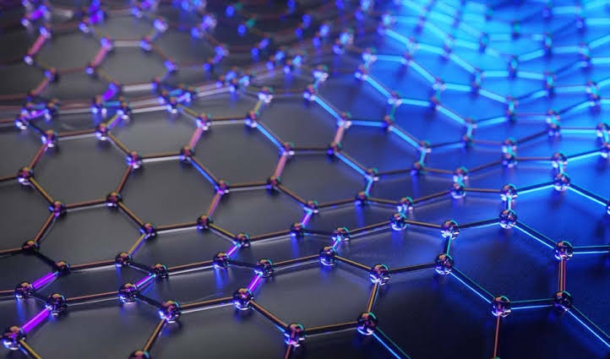
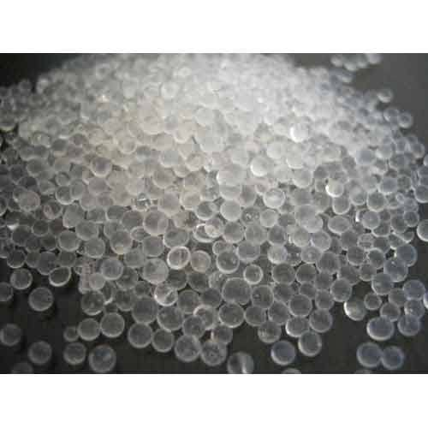
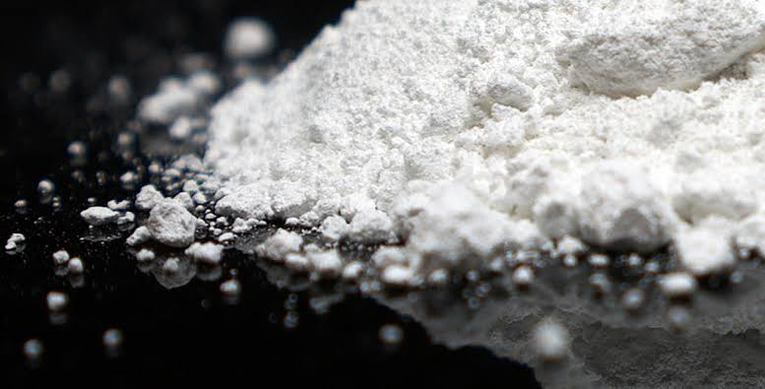


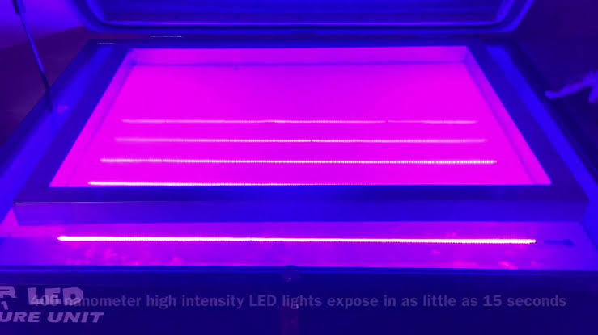
…APPLICATIONS
Nanofiller
Graphene
Silica
Property enhancement
Electrical conductivity,
Viscosity modification
Application
Electrical
Paint, adhesives
ZnO
UV adsorption
UV Screens

Slide 14
Future
Nanocomposites could achieve a dramatic commercialprominence is in advanced composites. Carbon fiberreinforced composites have a limit on the achievable properties due to the low modulus and strength of the matrixphase.
Modification of the matrix phase with carbon nanotubes at the lower scale of dimensions
Carbon nanofibers at a higher dimensional scale would allow for significant increases in the modulus and strength contributions of the matrix to the overall composite properties.
At present, it is difficult to predict which, if any, market sector would not be able to benefit from this technology.

Slide 15
Conclusion
Therefore, it may well be that polymeric nanocomposites in the mid and long term will pervade all aspects of life, similar to the way plastics did in the last century.
Clearly a diverse range of sectors such as :
Aerospace, automotive, packaging (particularly food but also solar cells).
Electrical and electronic goods, household goods, etc. will profit substantially from a new range of materials which would be offered by this technology.

Slide 16
References
M. Okamoto; Recent advances in polymer/layered
silicate nanocomposites
D.R.Paul, L.M.Robeson; Polymer nanotechnology:
Nanocomposites
Arunkumar Lagashetty, A Venkataraman; Polymer
Nanocomposites
Zahra Rafiee; New developments
in polymer science and technology
Zhang M,New developments
in polymer science

Slide 17
Thank You

Slide 18


